Slide 1

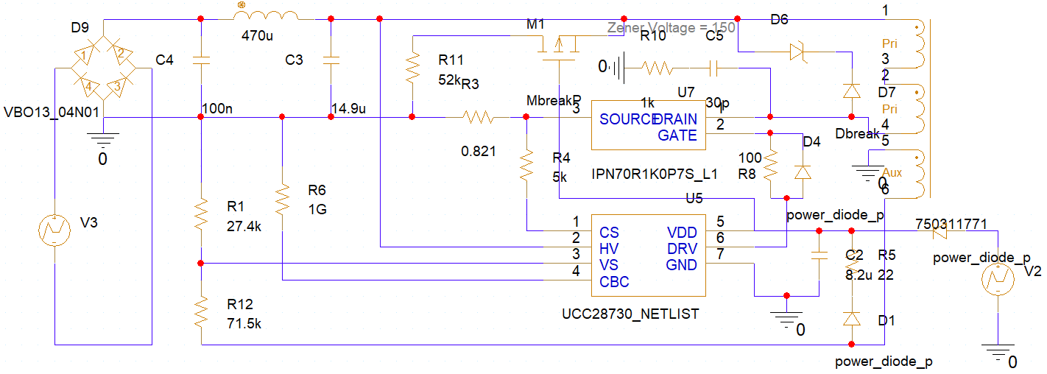
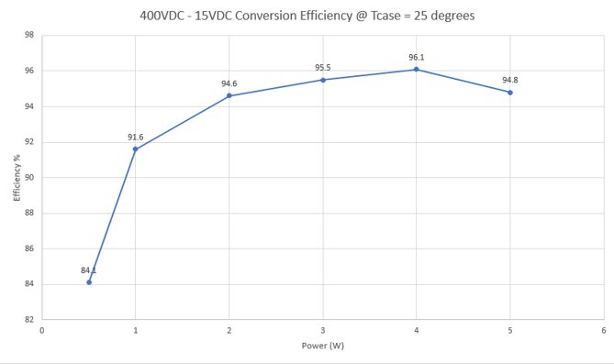
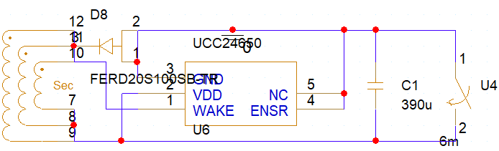
Main Switching Power Supply.
Efficiency
Passive PF Correction
Low Idle Power (5.18mW)
Variable Switching Speed
Up to 96.1% Efficiency (@4W 15VDC)
Reliability
Zero Electrolytic Caps
0.78 MOSFET Derating
Within dv/dt specification
Safety
Galvanically Isolated
OV and OC protection
Bulk Capacitor drain FET
Space for optional MOVs

Slide 2
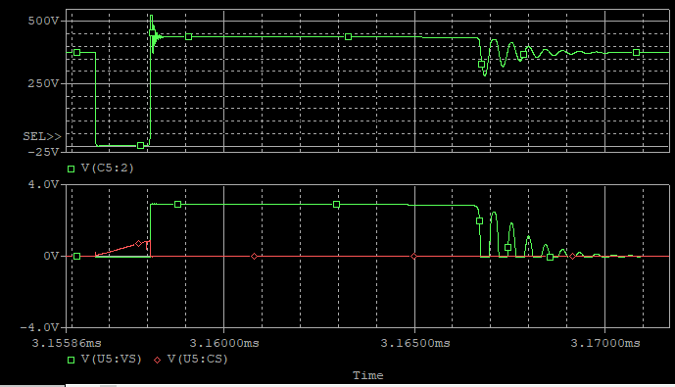
DCM and CCM operation
Clamped at 525VDC
Minimal gate ringing
Optimised for switching over conduction losses for low load performance.
Designed around pre-fab transformers.
Two transformer options available, as well as a capacitor charge pump design if needed.

